Slide 1

STM8S Training + LIS3DH

Slide 2
Agenda
STM8 Characteristics
LIS3DH Characteristics
Getting Started with the Software and Firmware
Compiler and IDE
Library
Hands-On
How to handle the GPIO & External Interrupt
How to implement an ADC convertion
How to generate a time base
Inclinometer

Slide 3
STM8S Training + LIS3DH
STM8 Characteristics

Slide 4
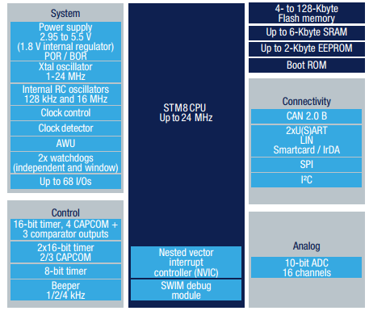
Internal block Diagram

Slide 5
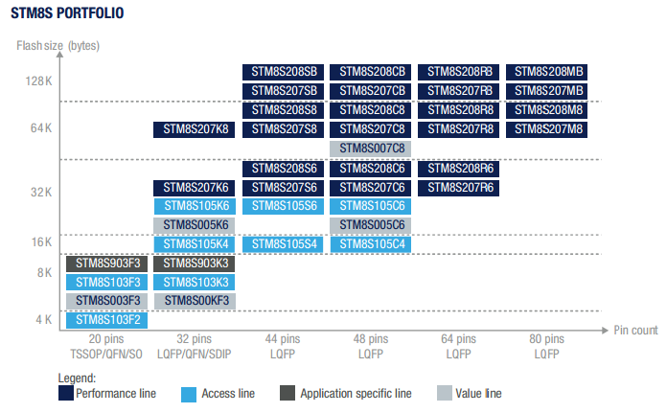
STM8S Portfolio

Slide 6
Important parameters
Upgrade to a higher or downgrade to a lower memory size, or use a different package across lines without changing the initial layout or software.
STM8 24 MHz CPU
4 to 128 Kbytes of embedded Flash memory, up to 6 Kbytes of SRAM
Supply voltage: 2.95 to 5.5 V
Up to four low‑power modes: down to 4 µA with complete context retention
State‑of‑the‑art digital and analog peripherals
Specific interfaces such as IrDA and smartcard for support of consumer applications
‑40 to +85 °C, or up to 125 °C temperature range
Free class B self‑diagnostic library for IEC 60335/IEC 60730 compliant applications
Many software libraries and examples are available for download

Slide 7
STM8S Training + LIS3DH
LIS3DH Characteristics

Slide 8
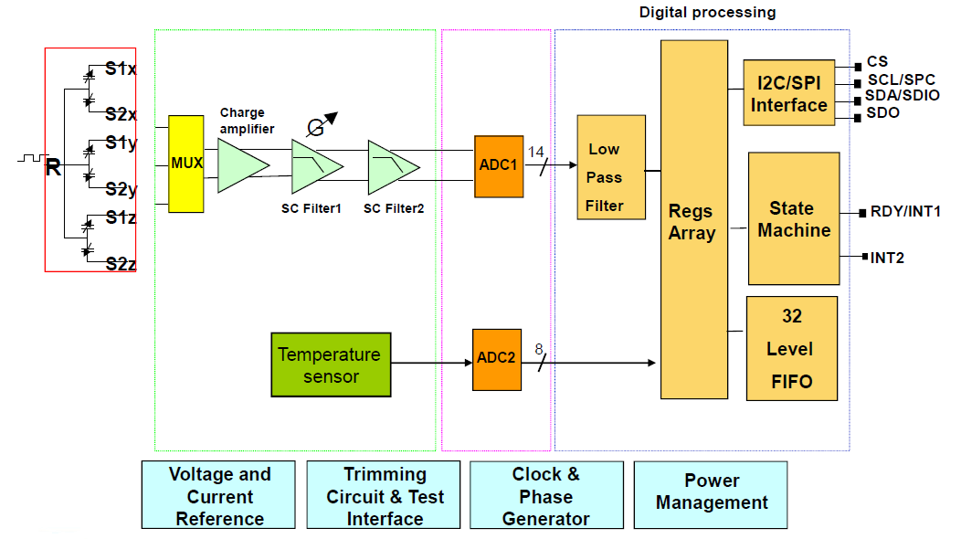
Internal Block Diagram

Slide 9
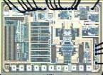
Important parameters
Full scale (measurement range): FS
Sensitivity: So
Zero-rate/g/Gauss offset
RMS Noise / Noise density
RMS Noise = Noise density * sqrt(Bandwidth)
Output data rate: ODR
Power consumption: Idd
Shock resistance (acceleration, magnetic field, over pressure etc.)

Slide 10
Where can I find the library and SW?
The evaluation board used is here
The generic driver that we’ll adapt is here
We also have a tool to help in the configuration for LIS3DH, available here
STEVAL-MKI105V1 | LIS3DH adapter board for standard DIL 24 socket
STSW-MEMS006 | Platform-independent device driver for LIS3DH

Slide 11
STM8S Training + LIS3DH
Getting Started

Slide 12
Where can I find the library and SW?
The library is available here
The STVD (our IDE!) is available here
The compiler is a 3rd part and has no limitation and it’s free!!
http://cosmicsoftware.com/download_stm8_free.php
STSW-STM8069 | STM8S/A Standard peripheral library
STVD | ST Visual develop IDE for developing ST7 and STM8 applications

Slide 13
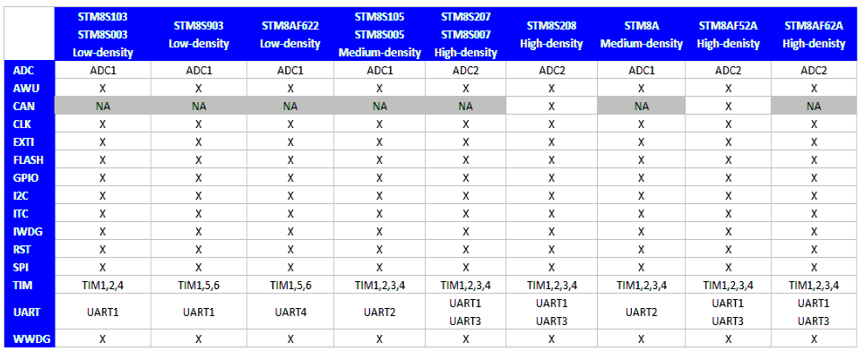
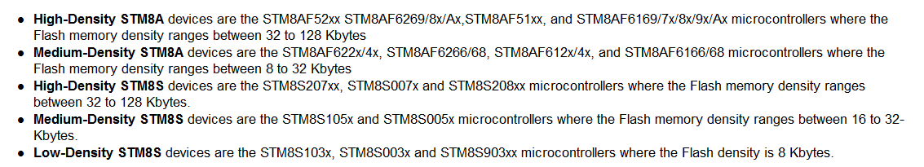
Library’s Supported Features

Slide 14
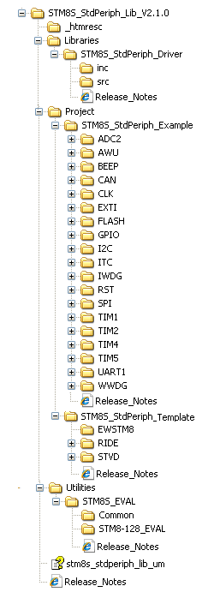
File Structure

Slide 15
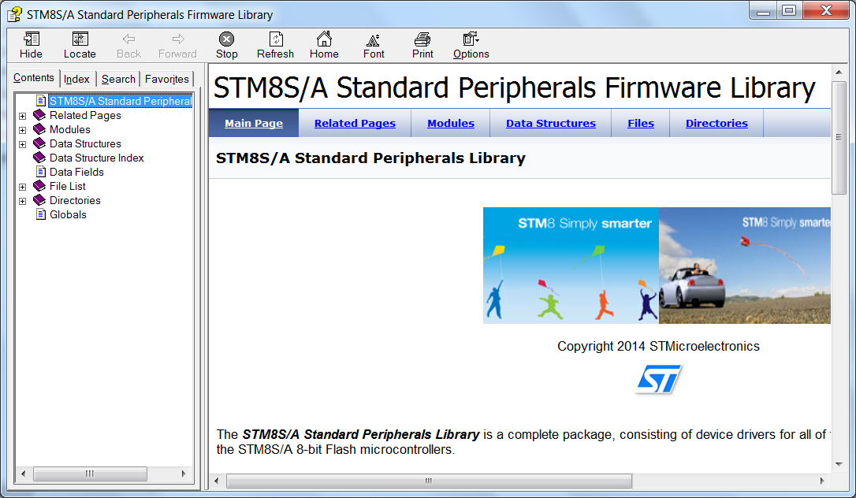
Library’s Help/User Manual

Slide 16
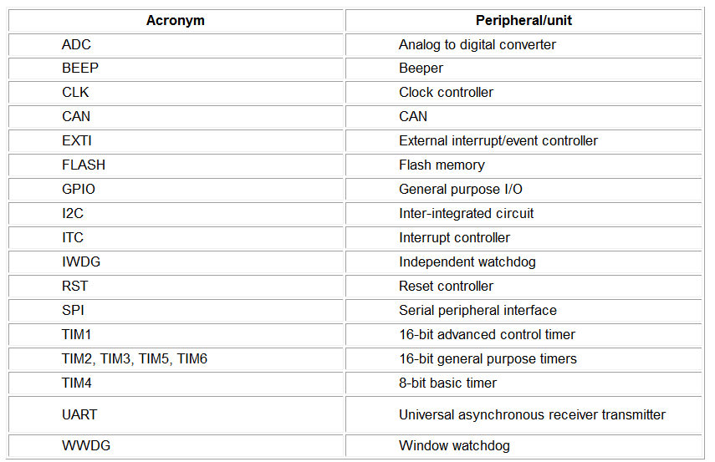
Conventions 1/3 ☺

Slide 17
Conventions 2/3 ☺
The library uses the following naming patern:
PPP refers to any peripheral acronym, for example TIM2 and TIM3
System and source/header file names are preceded by the prefix ‘stm8s_’.
Names of peripheral functions are preceded by the corresponding peripheral acronym in upper case followed by an underscore, for example SPI_SendData.
Functions used to initialize the PPP peripheral according to parameters specified in the header file are named PPP_Init, for example TIM2_Init
Functions used to reset the PPP peripheral registers to their default values are named PPP_DeInit, for example TIM2_DeInit
Functions used to enable or disable the specified PPP peripheral are named PPP_Cmd, for example SPI_Cmd
Functions used to enable or disable an interrupt source of the specified PPP peripheral are named PPP_ITConfig, for example SPI_ITConfig
Functions used to check whether the specified PPP flag is set or reset are named PPP_GetFlagStatus, for example I2C_GetFlagStatus
Functions used to clear a PPP flag are named PPP_ClearFlag, for example I2C_ClearFlag
Functions used to check whether the specified PPP interrupt has occurred or not are named PPP_GetITStatus, for example TIM2_GetITStatus
Functions used to clear a PPP interrupt pending bit are named PPP_ClearITPendingBit, for example TIM2_ClearITPendingBit

Slide 18
Conventions 3/3 ☺
Variable types:
#define __I volatile const /*!< defines 'read only' permissions */
#define __O volatile /*!< defines 'write only' permissions */
#define __IO volatile /*!< defines 'read / write' permissions */
/*!< Signed integer types */
typedef signed char int8_t;
typedef signed short int16_t;
typedef signed long int32_t;
/*!< Unsigned integer types */
typedef unsigned char uint8_t;
typedef unsigned short uint16_t;
typedef unsigned long uint32_t;
/*!< STM8 Standard Peripheral Library old types (maintained for legacy purpose) */
typedef int32_t s32;
typedef int16_t s16;
typedef int8_t s8;
typedef uint32_t u32;
typedef uint16_t u16;
typedef uint8_t u8;
typedef enum {FALSE = 0, TRUE = !FALSE} bool;
typedef enum {RESET = 0, SET = !RESET} FlagStatus, ITStatus, BitStatus, BitAction;
typedef enum {DISABLE = 0, ENABLE = !DISABLE} FunctionalState;

Slide 19
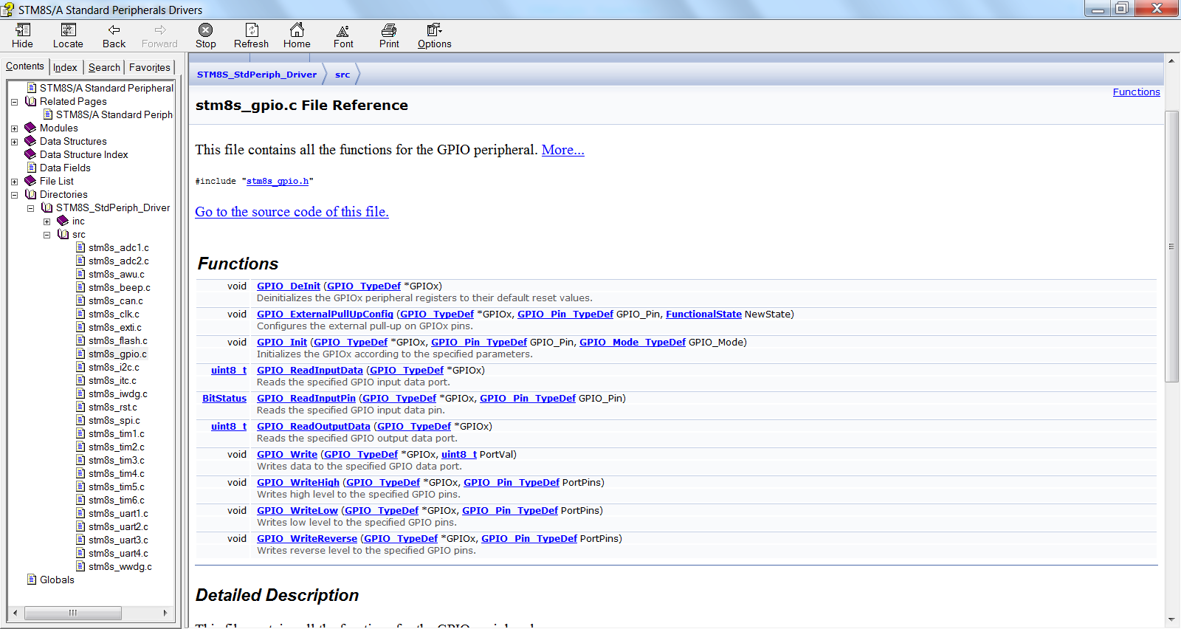
How to find the available functions

Slide 20
How to get more info?

Slide 21
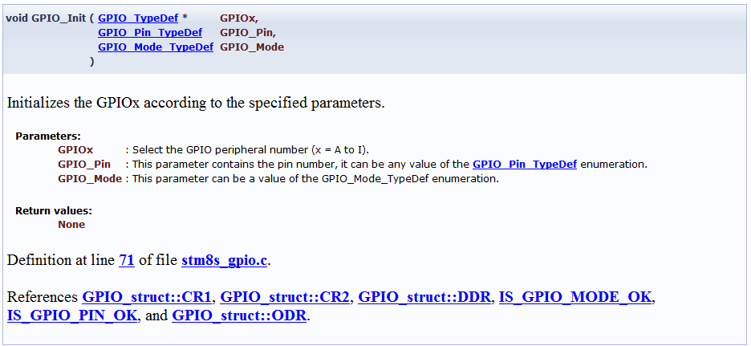
How to get more info?

Slide 22
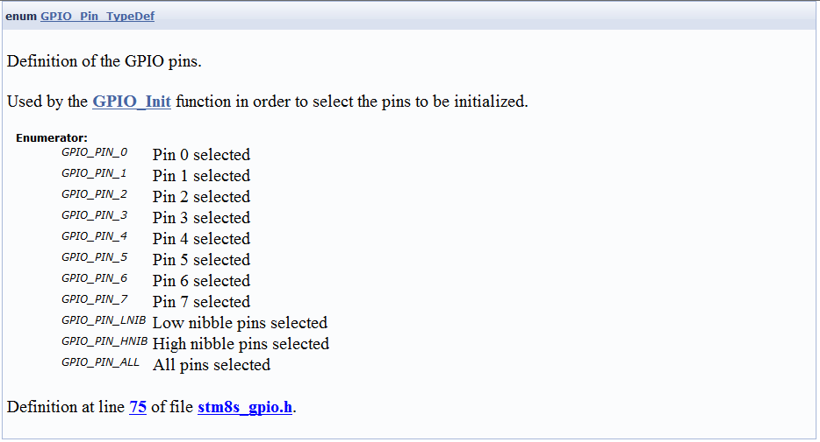
How to know the available defines?

Slide 23
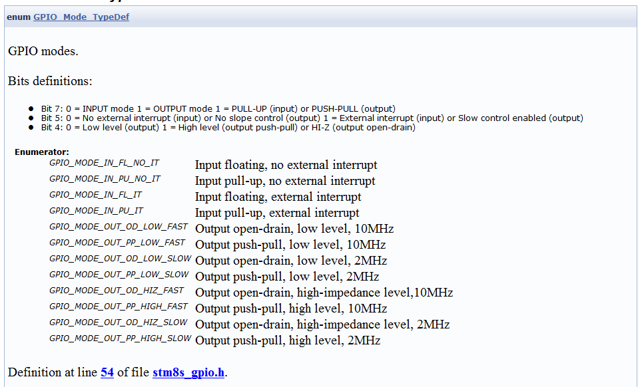
How to know the available defines?

Slide 24
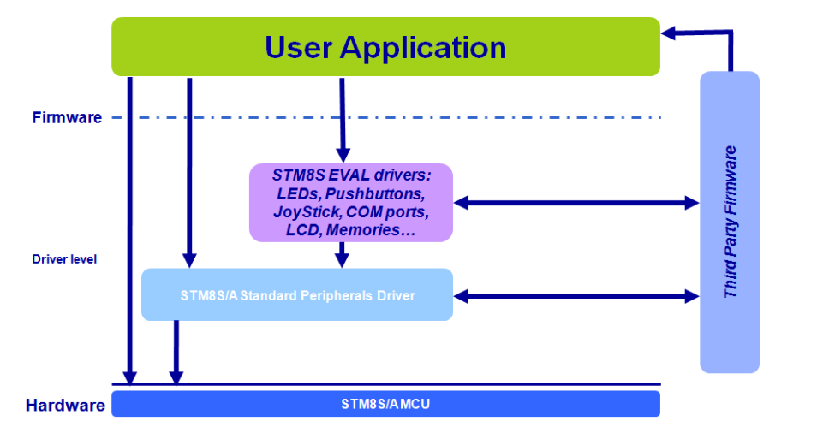
Library’s Architecture

Slide 25
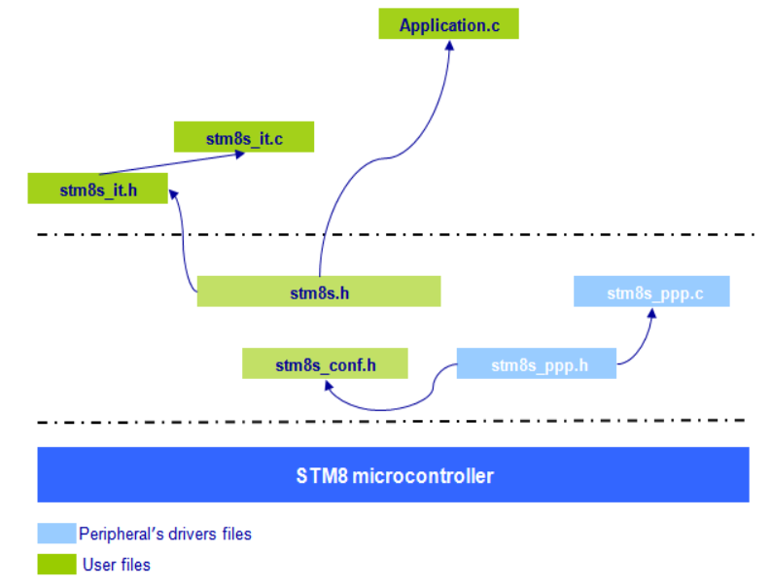
Library’s Architecture in files

Slide 26
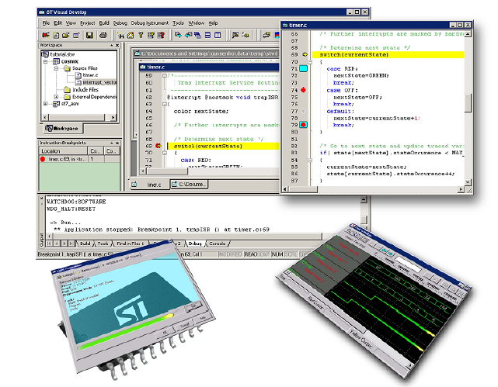
Getting Started from scratch!

Slide 27
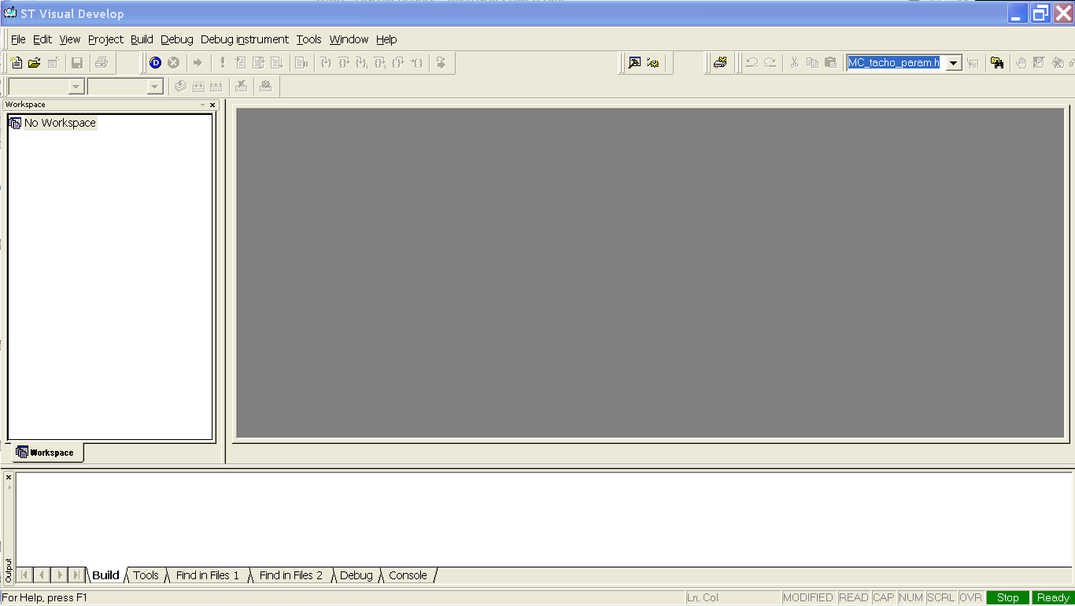
Open the STVD

Slide 28
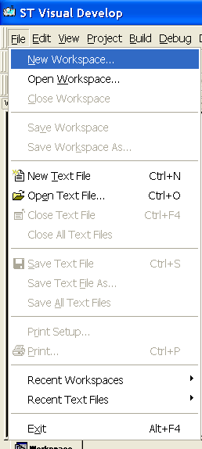
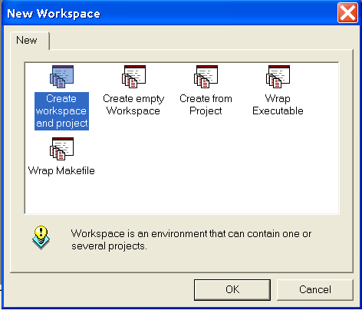
Choose to create a New Workspace
And then, to create workspace and project

Slide 29
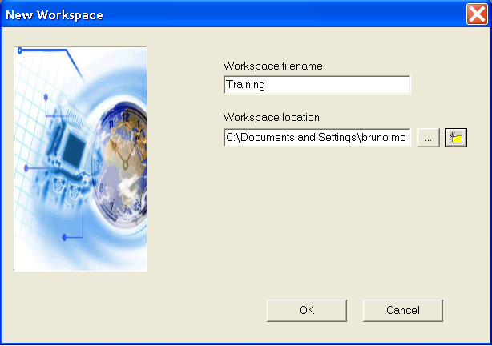
Name the workspace and set it’s location

Slide 30
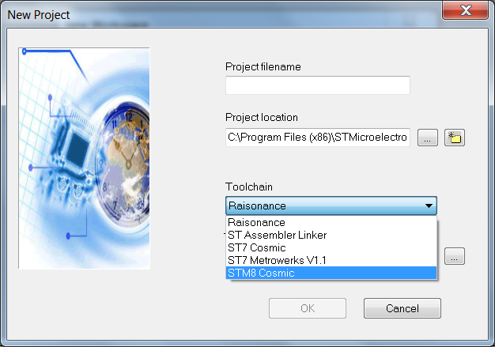
Select the proper Toolchain

Slide 31
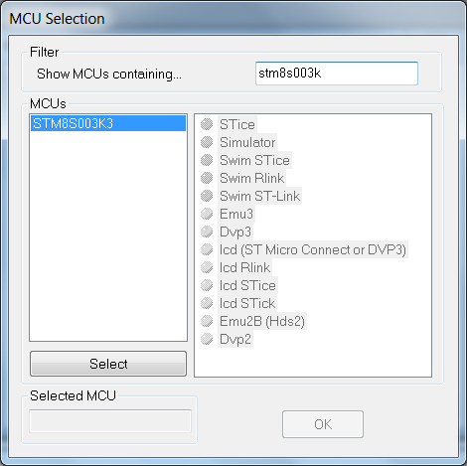
Select the STM8S003K3

Slide 32
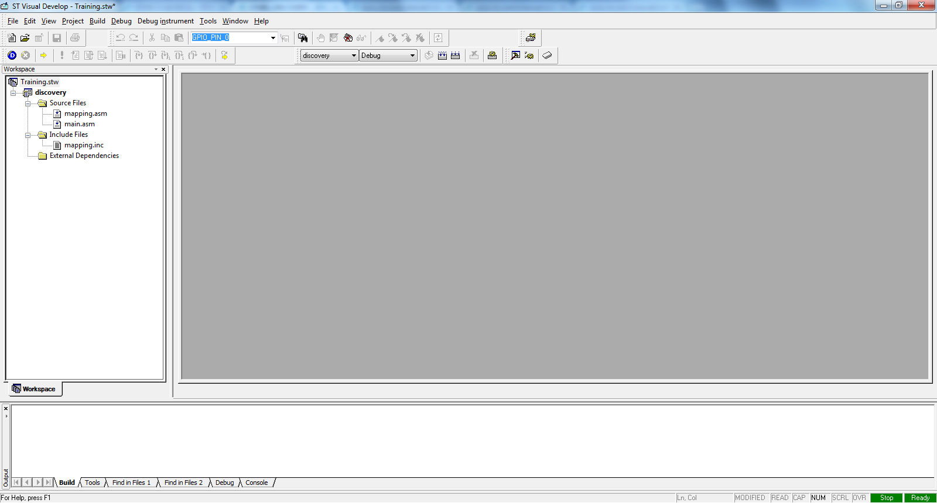
Your workspace should look like this

Slide 33
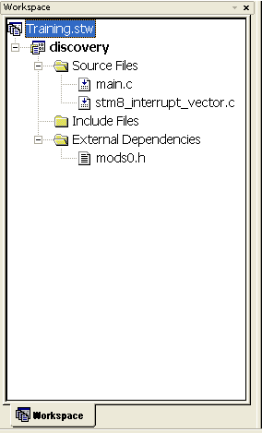
Giving a closer look

Slide 34
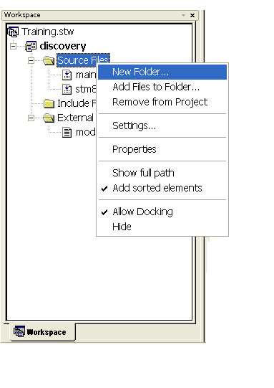
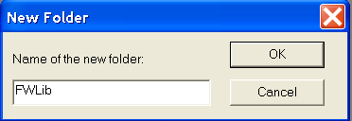
Now, let’s add the library

Slide 35
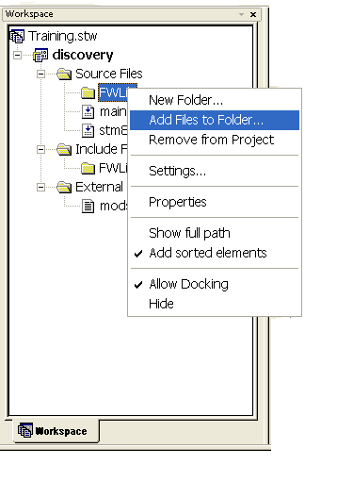
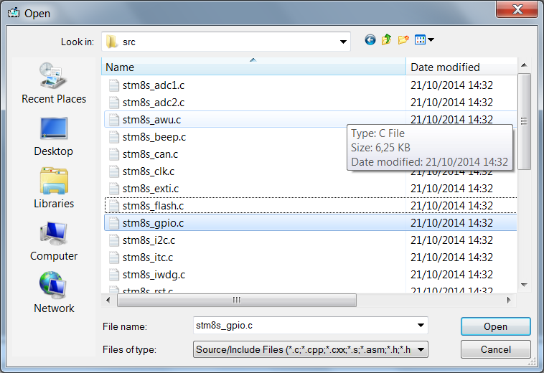
Now, let’s add the library

Slide 36
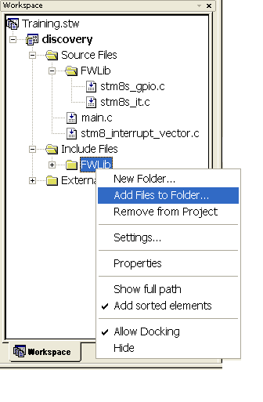
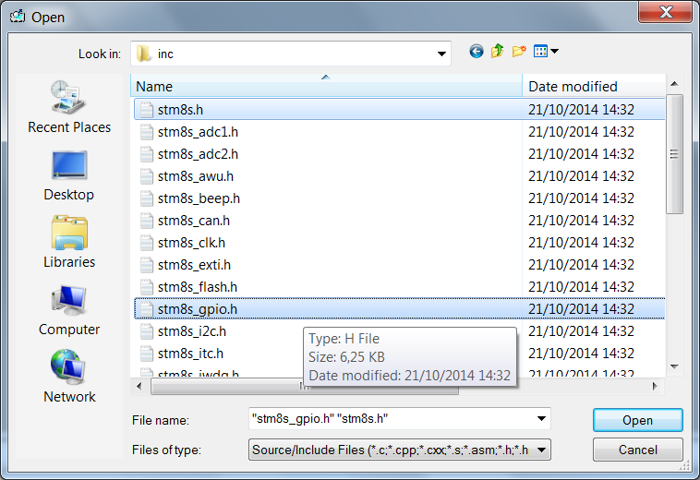
Now, let’s add the library

Slide 37
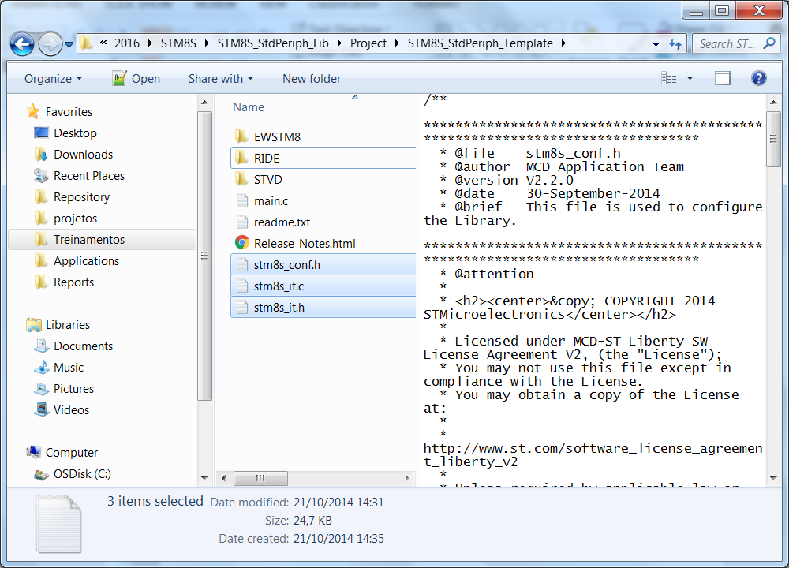
Now, let’s add the library
Once the basic files are imported, we need to add the files responsibles to manage the interrupt vector
Copy the 3 highlighted files to our project folder, these files are available under the unzip library folder: STM8S_StdPeriph_Lib\Project\STM8S_StdPeriph_Template

Slide 38
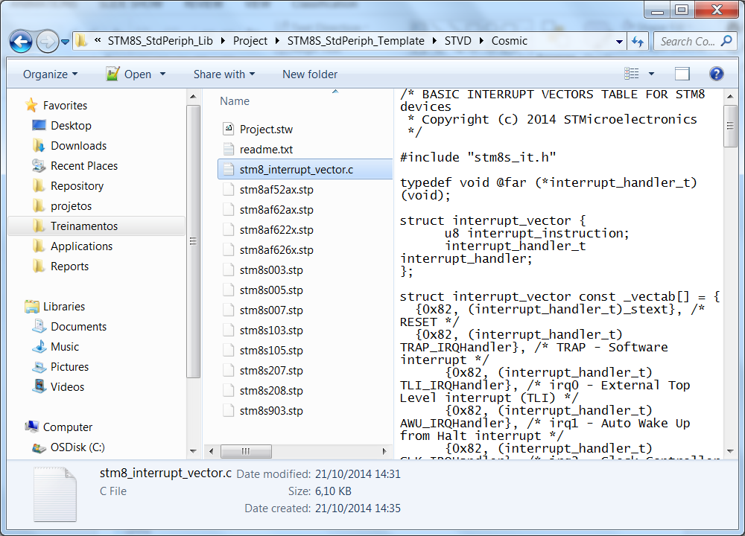
Now, let’s add the library
Since the interrupt vector file that is automatically generated is not asserted with the library’s names, we need to replace the file
Copy the highlighted file to our project folder, this file is available under the unzip library folder: STM8S_StdPeriph_Lib\Project\STM8S_StdPeriph_Template\STVD\Cosmic

Slide 39
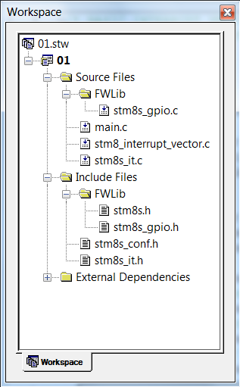
Now, let’s add the library
With all the preparations done, we just need to add the following files within our project:
stm8s_it.c
stm8s_it.h
stm8s_conf.h
The final result should be like this:

Slide 40
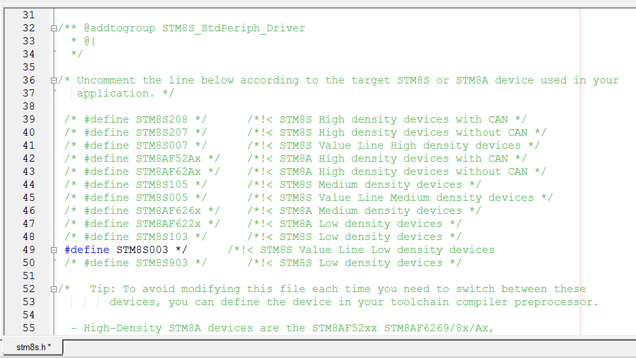
Configuring the library – stm8s.h

Slide 41
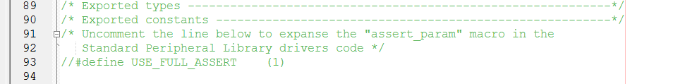
Configuring the library – stm8s_conf.h
The Standard Peripherals Library implements run-time failure detection by checking the input values of all library functions. The run-time checking is achieved by using an assert_param macro. This macro is used in all library functions which have at least an input parameter. It allows the user to check that the input value lies within the defined parameter values
For the purpouse of this training, we won’t use this feature, so it’s mandatory to comment the assert define:

Slide 42
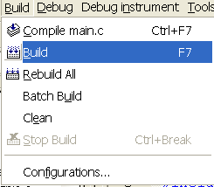
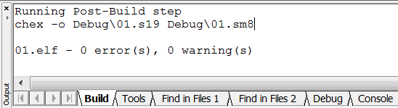
Compile the project (F7 as short key)
Once all is done, just compile and get the so desired 0 erros and 0 warnings

Slide 43
STM8S Training + LIS3DH
Tec. Char.

Slide 44
Programming interface - General Info
SWIM (Single Wire Interface Module):
Direct access to all memory content and RAM
The overall information is transmitted at a 145bytes/ms rate
We do have a simple Stand Alone programmer based on the STM8S discovery kit

Slide 45
Interrupt – General Info
3 software priorities
32 interrupt vectors already with hardware priorities
Trap and reset interrupts
27 external interrupts, distributed in 6 different vectors

Slide 46
Flash and EEPROM for the 003
This micro has 8Kb of flash
128B de EEPROM
It doesn’t have the feature Read while Write. Any micro with 16KB or more has this this feature

Slide 47
Clock
Startup clock: After the reset, the system clock is automatically set to the minimum: 2MHz (HSI/8)
CSS: this feature can be enabled to verify any issues under the HSE and automatically change back to HSI, avoiding any unexpected stop

Slide 48
STM8S Training + LIS3DH
Hands-On

Slide 49
Hands On
GPIO
ADC
TIM4
UART
INCLINOMETER

Slide 50
Hands On
GPIO
ADC
TIM4
UART
INCLINOMETER

Slide 51
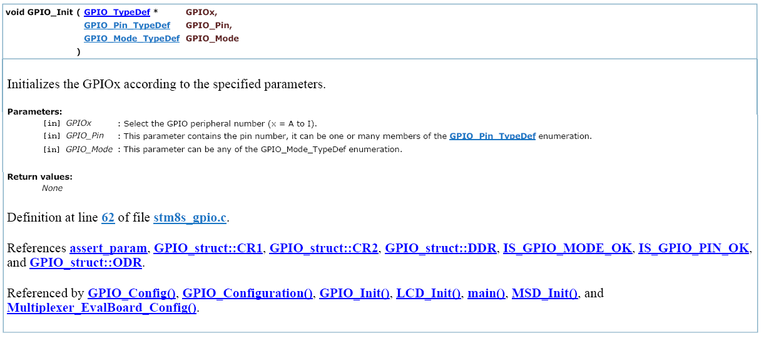
Library

Slide 52
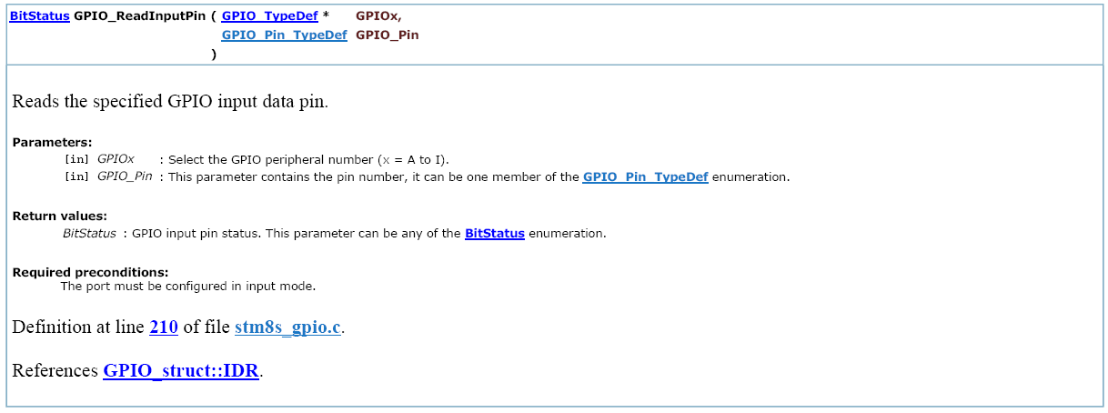
Library

Slide 53
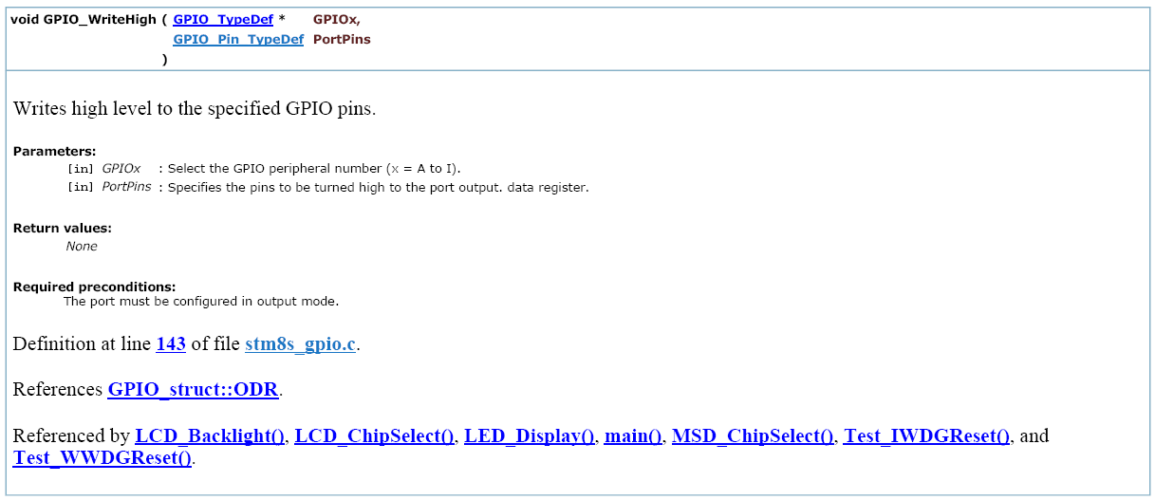
Library

Slide 54
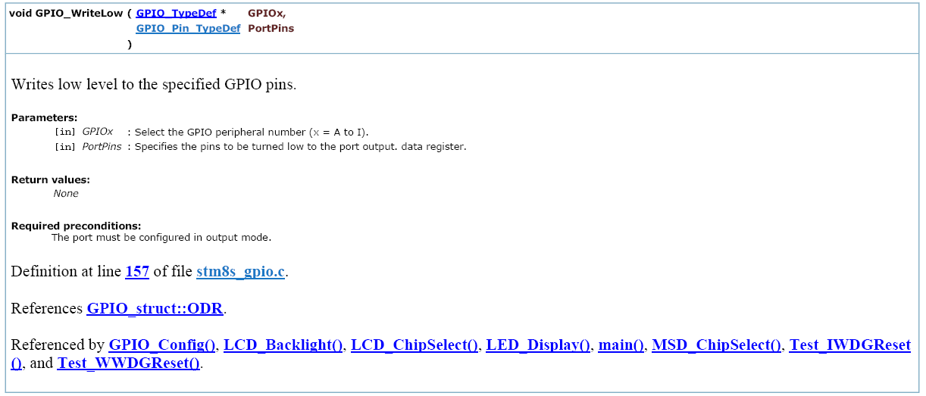
Library

Slide 55
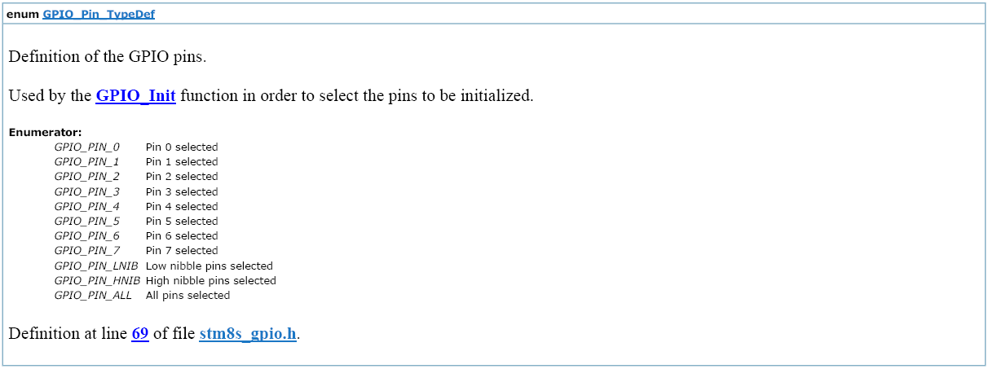
Library

Slide 56
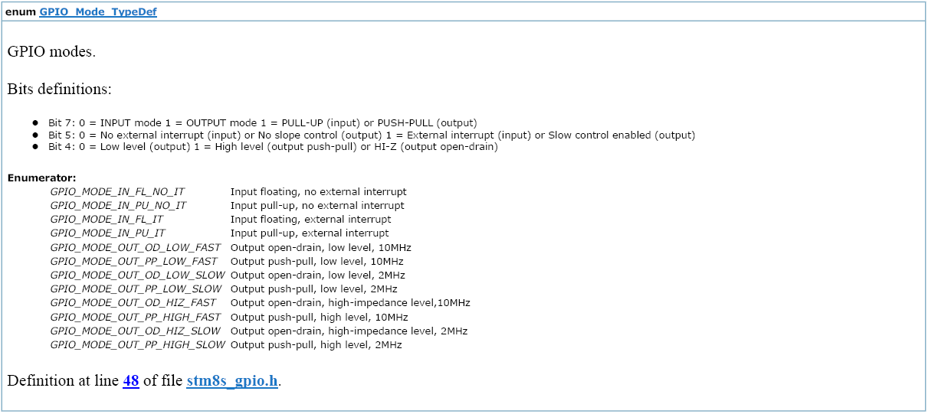
Library

Slide 57
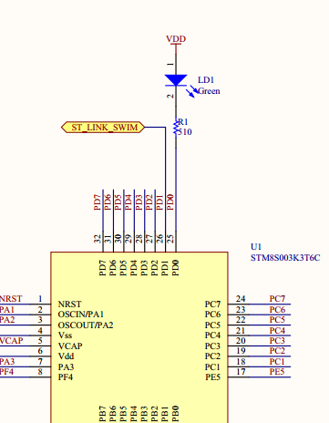
GPIO
Turn on and off a simple LED
#include "stm8s.h"
void Delay(u16 nCount)
{
/* Decrement nCount value */
while (nCount != 0)
{
nCount--;
}
}
main()
{
GPIO_Init(GPIOD,GPIO_PIN_0,GPIO_MODE_OUT_PP_HIGH_SLOW);
while (1)
{
GPIO_WriteLow(GPIOD,GPIO_PIN_0);
Delay(9000);
GPIO_WriteHigh(GPIOD,GPIO_PIN_0);
Delay(9000);
}
}

Slide 58
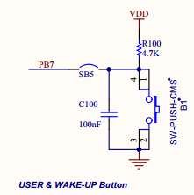
GPIO
Blink a simple LED, depending on the key status
#include "stm8s.h"
void Delay(u16 nCount)
{
/* Decrement nCount value */
while (nCount != 0)
{
nCount--;
}
}
main()
{
GPIO_Init(GPIOD,GPIO_PIN_0,GPIO_MODE_OUT_PP_HIGH_SLOW);
GPIO_Init(GPIOB,GPIO_PIN_7,GPIO_MODE_IN_PU_NO_IT);
while (1)
{
if(GPIO_ReadInputPin(GPIOB,GPIO_PIN_7) == RESET)
{
GPIO_WriteLow(GPIOD,GPIO_PIN_0);
}
else
{
GPIO_WriteHigh(GPIOD,GPIO_PIN_0);
}
Delay(9000);
}
}

Slide 59
GPIO
Blink a simple LED, depending on the key status, using external interrupt
To accomplish this task, we’ll need to add the stm8s_exti.c/h in the project
main.c
stm8s_it.c
#include "stm8s.h"
main()
{
GPIO_Init(GPIOD,GPIO_PIN_0,GPIO_MODE_OUT_PP_HIGH_SLOW);
GPIO_Init(GPIOB,GPIO_PIN_7,GPIO_MODE_IN_PU_IT);
EXTI_SetExtIntSensitivity(EXTI_PORT_GPIOB,EXTI_SENSITIVITY_FALL_ONLY);
enableInterrupts();
while (1)
{
}
}
INTERRUPT_HANDLER(EXTI_PORTB_IRQHandler, 4)
{
/* In order to detect unexpected events during development,
it is recommended to set a breakpoint on the following instruction.
*/
GPIO_WriteReverse(GPIOD,GPIO_PIN_0);
}

Slide 60
Hands On
GPIO
ADC
TIM4
UART
INCLINOMETER

Slide 61
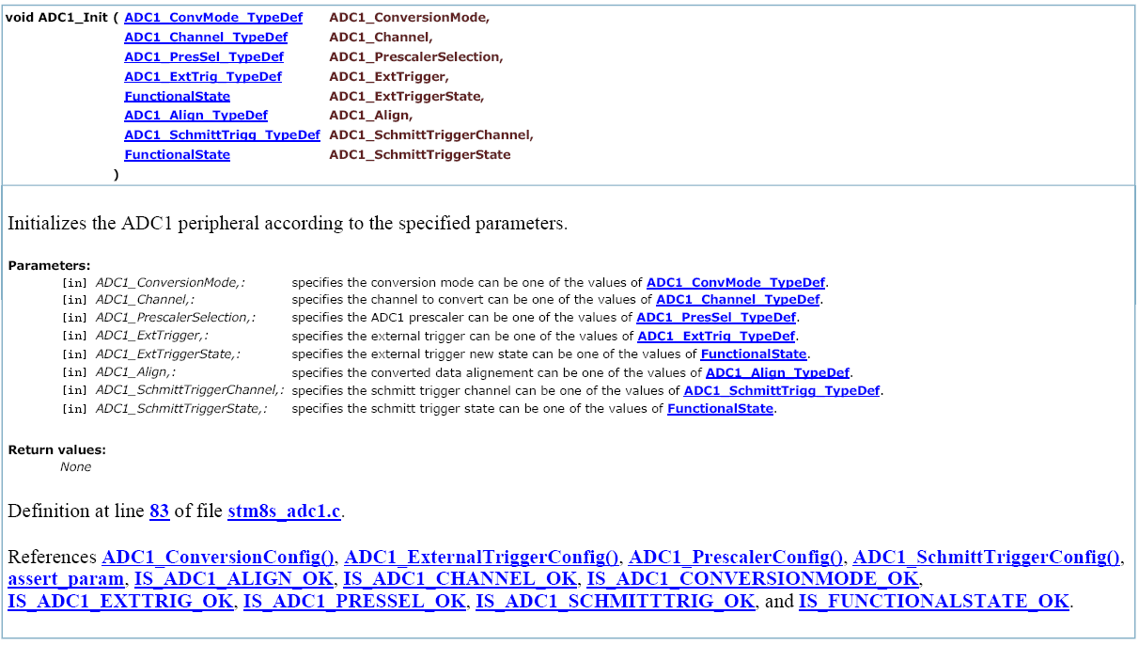
Library

Slide 62
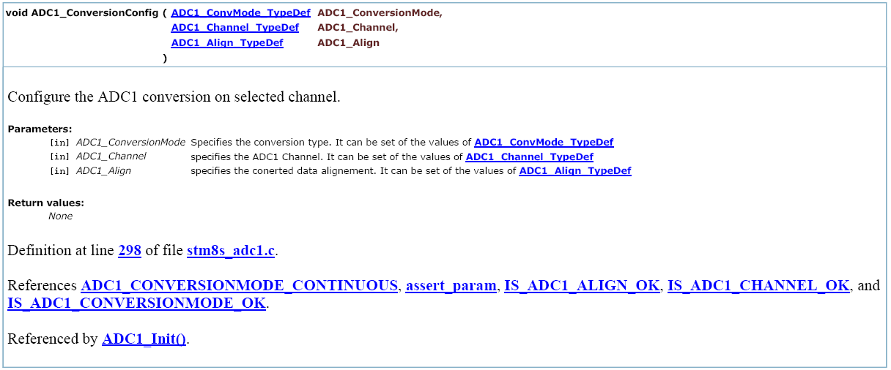
Library

Slide 63
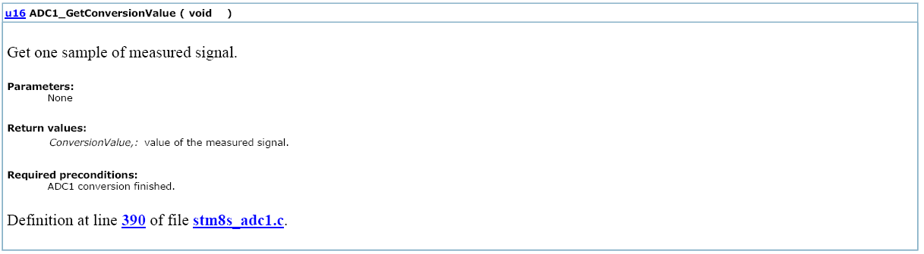
Library

Slide 64
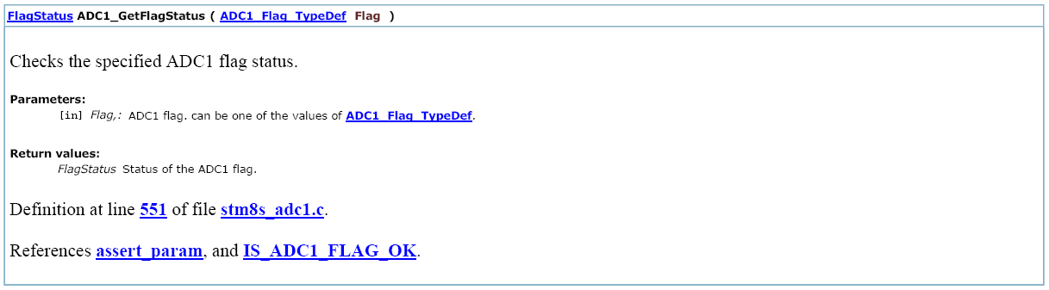
Library

Slide 65
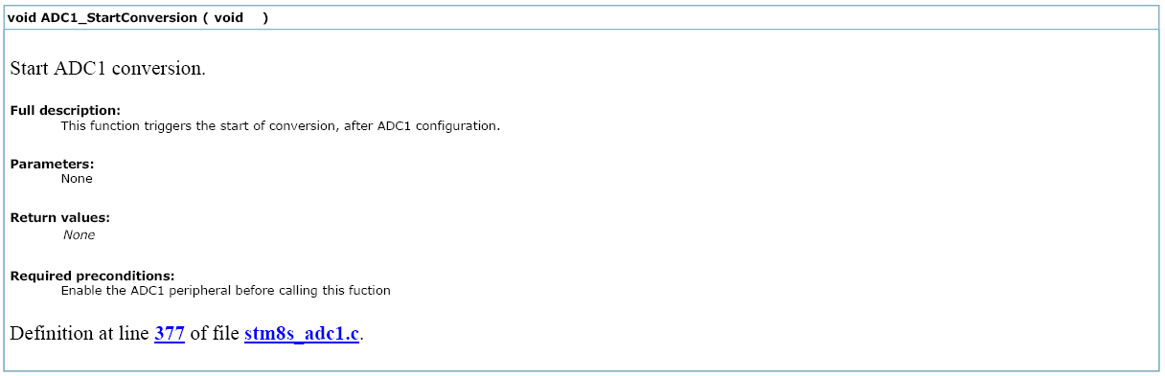
Library

Slide 66

Library

Slide 67

Library

Slide 68
ADC
Let’s monitor the ADC value!
To accomplish this task, we’ll need to add the stm8s_adc1.c/h in the project
main.c
To monitor de ADC_Value variable, select it under debug and use the quick watch feature, once enable, right-click in the green area and change it to Read/Write On Fly, the screen selection will turn yellow
#include "stm8s.h"
u16 ADC_Value;
main()
{
GPIO_Init(GPIOB,GPIO_PIN_0,GPIO_MODE_IN_FL_NO_IT );
ADC1_Init(ADC1_CONVERSIONMODE_CONTINUOUS,ADC1_CHANNEL_0,ADC1_PRESSEL_FCPU_D2,
ADC1_EXTTRIG_TIM,DISABLE,ADC1_ALIGN_RIGHT,ADC1_SCHMITTTRIG_CHANNEL0,DISABLE);
ADC1_Cmd(ENABLE);
ADC1_StartConversion();
while (1)
{
if(ADC1_GetFlagStatus(ADC1_FLAG_EOC))
{
ADC_Value = ADC1_GetConversionValue();
}
}
}

Slide 69
Hands On
GPIO
ADC
TIM4
UART
INCLINOMETER

Slide 70

Block Diagram

Slide 71

Library

Slide 72

Library

Slide 73

Library

Slide 74

Library

Slide 75

Library

Slide 76

Library

Slide 77
TIM4
Let’s configure the TIM4 to have a 1KHz frequency and blink our LED every second, using interrupt!
To accomplish this task, we’ll need to add the stm8s_tim4.c/h in the project
main.c
stm8s_it.c
#include "stm8s.h"
main()
{
GPIO_Init(GPIOD,GPIO_PIN_0,GPIO_MODE_OUT_PP_HIGH_SLOW);
TIM4_TimeBaseInit(TIM4_PRESCALER_16,124);
TIM4_ITConfig(TIM4_IT_UPDATE,ENABLE );
TIM4_Cmd(ENABLE);
enableInterrupts();
while (1) {
}
}
INTERRUPT_HANDLER(TIM4_UPD_OVF_IRQHandler, 23){
static u16 Counter = 0;
TIM4_ClearITPendingBit(TIM4_IT_UPDATE);
if(Counter >= 999){
GPIO_WriteReverse(GPIOD,GPIO_PIN_0);
Counter = 0;
}
else{
Counter++;
}
}

Slide 78
Hands On
GPIO
ADC
TIM4
UART
INCLINOMETER

Slide 79

Library

Slide 80

Library

Slide 81

Library

Slide 82

UART
Let’s Configure UART to enter in loopback mode and receive what we send! Receive using interrupt

Slide 83
UART
#include "stm8s.h"
main()
{
GPIO_Init(GPIOD,GPIO_PIN_0,GPIO_MODE_OUT_PP_HIGH_SLOW);
GPIO_Init(GPIOD,GPIO_PIN_5,GPIO_MODE_OUT_PP_LOW_FAST);
GPIO_Init(GPIOD,GPIO_PIN_6,GPIO_MODE_IN_PU_NO_IT);
UART1_Init(9600, UART1_WORDLENGTH_8D,
UART1_STOPBITS_1, UART1_PARITY_NO,
UART1_SYNCMODE_CLOCK_DISABLE, UART1_MODE_TXRX_ENABLE);
UART1_ITConfig(UART1_IT_RXNE_OR,ENABLE);
UART1_Cmd(ENABLE);
enableInterrupts();
UART1_SendData8('a');
while(UART1_GetFlagStatus(UART1_IT_TC) == RESET);
Delay(1000);
UART1_SendData8('b');
while(UART1_GetFlagStatus(UART1_IT_TC) == RESET);
Delay(1000);
UART1_SendData8('c');
while(UART1_GetFlagStatus(UART1_IT_TC) == RESET);
Delay(1000);
while (1) {
}
}

Slide 84
UART
INTERRUPT_HANDLER(UART1_RX_IRQHandler, 18)
{
static char i = 0;
recebe[i] = UART1_ReceiveData8();
UART1_ClearITPendingBit(UART1_IT_RXNE);
i++;
}

Slide 85
Hands On
GPIO
ADC
TIM4
UART
INCLINOMETER

Slide 86
Device connections
Power supply
Separated Vdd (for measurement chain) and Vdd_IO lines (for digital part)
Supply voltage range: depends on device
LIS3DH: 1.71 to 3.6V for both, LSM303D: 2.16-3.6V for Vdd, 1.71-3.6V for VDD_IO
VDD_IO <= VDD
Most sensors are capable to communicate over SPI and I2C digital serial interfaces, but always only one at a time.
Device setup and data acquisition is done by accessing registers of the device
INT1 and INT2 interrupts pins have programmable functionality
MCU
SPI or I2C
MEMS
INT1
INT2

Slide 87

Serial interfaces
SPI
2 options: 3-wire(CS, SPC, SDI/O) , 4-wire (CS, SPC, SDI, SDO)
CS must be low during the whole transaction
Clock speed up to 10MHz
I²C (SCL, SDA)
LSb of slave address selectable by SA0 pin
When there is a choice, SA0=VDD_IO slave address should be selected, otherwise extra power consumption is dissipated on an internal pull-up.
Clock speed 100 / 400 kHz
CS pin is used to select between SPI and I²C

Slide 88

Electrical connections
LIS3DSH electrical connections
Couple of filtering capacitors and for some devices also few other external components needed.
Pull-up resistors should be placed on I²C lines when I²C interface is used.
When there is a choice and interface is I²C, SA0=VDD_IO slave address should be selected.

Slide 89

INCLINOMETER
Let’s Configure SPI (red) + EXTI(blue) to interface with the LIS3DH

Slide 90
INCLINOMETER – main.c
/*
*Arquivo main
*/
//------------------------------------------------------------------------------
#include "stm8s.h"
#include "defines.h"
#include "lis3dh_driver.h"
//------------------------------------------------------------------------------
extern AxesRaw_t leitura;
extern AxesRaw_t leitura_inicial;
extern float Angulo;
//------------------------------------------------------------------------------
//------------------------------------------------------------------------------
void Delay_ms (u16 tempo)
{
Count_ms = tempo;
while(Count_ms);
}
//------------------------------------------------------------------------------
main()
{
CLK->CKDIVR = 0x00; // Master clock at 16MHz
/* Enable TIM4 CLK */
CLK_PeripheralClockConfig(CLK_PERIPHERAL_TIMER4, ENABLE);
/* Enable TIM4 */
TIM4_TimeBaseInit(TIM4_PRESCALER_128, 124);
TIM4_ITConfig(TIM4_IT_UPDATE, ENABLE);
TIM4_Cmd(ENABLE);
Buttons_Init();
LIS3DH_Init();
enableInterrupts();
/* Infinite loop */
while (1)
{
if(DataReady)
{
DataReady = 0;
Angulo = GetAngle(leitura.AXIS_X,leitura.AXIS_Y,leitura.AXIS_Z,0,0,GRAVIDADE);
}
}
}

Slide 91
INCLINOMETER – stm8s_it.c
/* Includes ------------------------------------------------------------------*/
#include "stm8s_it.h"
#include "defines.h"
/**
* @brief External Interrupt PORTB Interrupt routine.
* @param None
* @retval None
*/
@svlreg INTERRUPT_HANDLER(EXTI_PORTB_IRQHandler, 4)
{
Buttons_ISR();
}
/**
* @brief External Interrupt PORTC Interrupt routine.
* @param None
* @retval None
*/
@svlreg INTERRUPT_HANDLER(EXTI_PORTC_IRQHandler, 5)
{
LIS3DH_INT1_ISR();
}
/**
* @brief External Interrupt PORTD Interrupt routine.
* @param None
* @retval None
*/
@svlreg INTERRUPT_HANDLER(EXTI_PORTD_IRQHandler, 6)
{
LIS3DH_INT2_ISR();
}
/**
* @brief Timer4 Update/Overflow Interrupt routine.
* @param None
* @retval None
*/
INTERRUPT_HANDLER(TIM4_UPD_OVF_IRQHandler, 23)
{
TIM4_ClearITPendingBit(TIM4_IT_UPDATE);
if(Count_ms)
{
Count_ms--;
}
}

Slide 92
INCLINOMETER – controle.c
#include "defines.h"
#include "lis3dh_driver.h"
#include <math.h>
#define READ_REG 1
#define Transf_graus 57.29578//180 graus dividido por pi
float Angulo;
extern AxesRaw_t leitura;
extern AxesRaw_t leitura_inicial;
extern u8 StatusRegVar;
extern u8 StatusAUXVar;
void LIS3DH_INT2_ISR(void)
{
//Configura o pino MISO
GPIO_Init(SPI_MISO,GPIO_MODE_IN_FL_NO_IT);
//Configura o pino MOSI
GPIO_Init(SPI_MOSI,GPIO_MODE_OUT_PP_LOW_FAST);
//Configura o pino SCK
GPIO_Init(SPI_SCK,GPIO_MODE_OUT_PP_LOW_FAST);
//Configura o pino de chip select
GPIO_Init(CHIPSELECT,GPIO_MODE_OUT_PP_LOW_FAST);
CLK_PeripheralClockConfig(CLK_PERIPHERAL_SPI, ENABLE);
SPI_Cmd(ENABLE);
LIS3DH_ResetInt2Latch();
LIS3DH_GetStatusReg(&StatusRegVar);
LIS3DH_GetStatusAUX(&StatusAUXVar);
LIS3DH_GetAccAxesRaw(&leitura);
}
void LIS3DH_INT1_ISR(void)
{
//Configura o pino MISO
GPIO_Init(SPI_MISO,GPIO_MODE_IN_FL_NO_IT);
//Configura o pino MOSI
GPIO_Init(SPI_MOSI,GPIO_MODE_OUT_PP_LOW_FAST);
//Configura o pino SCK
GPIO_Init(SPI_SCK,GPIO_MODE_OUT_PP_LOW_FAST);
//Configura o pino de chip select
GPIO_Init(CHIPSELECT,GPIO_MODE_OUT_PP_LOW_FAST);
CLK_PeripheralClockConfig(CLK_PERIPHERAL_SPI, ENABLE);
SPI_Cmd(ENABLE);
LIS3DH_ResetInt1Latch();
LIS3DH_GetStatusReg(&StatusRegVar);
LIS3DH_GetStatusAUX(&StatusAUXVar);
LIS3DH_GetAccAxesRaw(&leitura);
DataReady = 1;
}
void Buttons_ISR (void)
{
//Verifica a origem da interrupçãp
if(!GPIO_ReadInputPin(ABRE))
{
//adicionar qualquer função para tecla pressionada, como low power mode
}
else
{
//erro de leitura
}
}

Slide 93
INCLINOMETER – controle.c
void LIS3DH_Init(void)
{
//Configura o pino MISO
GPIO_Init(SPI_MISO,GPIO_MODE_IN_FL_NO_IT);
//Configura o pino MOSI
GPIO_Init(SPI_MOSI,GPIO_MODE_OUT_PP_LOW_FAST);
//Configura o pino SCK
GPIO_Init(SPI_SCK,GPIO_MODE_OUT_PP_LOW_FAST);
//Configura o pino de chip select
GPIO_Init(CHIPSELECT,GPIO_MODE_OUT_PP_LOW_FAST);
//Configura o pino de interrupção proveniente do acelerometro
GPIO_Init(INTERRUPT1,GPIO_MODE_IN_FL_IT);
//Configura a sensibilidade de borda da interrupção do acelerometro
EXTI_SetExtIntSensitivity(INTERRUPT1_SENSIBILIDADE);
//Configura o pino de interrupção proveniente do acelerometro
GPIO_Init(INTERRUPT2,GPIO_MODE_IN_FL_IT);
//Configura a sensibilidade de borda da interrupção do acelerometro
EXTI_SetExtIntSensitivity(INTERRUPT2_SENSIBILIDADE);
//Configura prioridade da interrupção proveniente do MEMS
ITC_SetSoftwarePriority(ITC_IRQ_PORTC, ITC_PRIORITYLEVEL_1);
ITC_SetSoftwarePriority(ITC_IRQ_PORTD, ITC_PRIORITYLEVEL_1);
CLK_PeripheralClockConfig(CLK_PERIPHERAL_SPI, ENABLE);
//Configura a SPI em modo Master, com as especificações do acelerometro
SPI_Init(SPI_FIRSTBIT_MSB, SPI_BAUDRATEPRESCALER_16, SPI_MODE_MASTER, SPI_CLOCKPOLARITY_HIGH,SPI_CLOCKPHASE_2EDGE, SPI_DATADIRECTION_2LINES_FULLDUPLEX,SPI_NSS_SOFT,0x07);
//Desabilita o CRC
SPI->CR2 &= 0xDF;
//Habilita SPI
SPI_Cmd(ENABLE);
//Habilita as interrupções
enableInterrupts();
//Inicializa o acelerometro
MEMS_Startup();
}

Slide 94
How to start up the MEMS with the desired configuration?
This software is meant to ease the use of the LIS2DH and LIS3DH accelerometers, by letting users setting up registers in an easy and “friendly” way. This tool will come very handy during debugging or just discovering phase.
All registers can be set or changed by setting up values directly or by checking register’s options. Once the register setup is complete, the setup can be saved into a file and reloaded for later use. The file can also be shared with Unico GUI

Slide 95

MEMS Enabler
This setup will allow the DataReady Interrupt to be directed to INT1 and the OutputDataRate to be at 100Hz with 2G scale in LowPowerMode

Slide 96
INCLINOMETER – controle.c
/**
* Inicializa o acelerometro
**/
void MEMS_Startup (void)
{
LIS3DH_GetWHO_AM_I(&WhoAmI);
LIS3DH_WriteReg(LIS3DH_TEMP_CFG_REG, 0x00);
LIS3DH_WriteReg(LIS3DH_CTRL_REG1, 0x5F);
LIS3DH_WriteReg(LIS3DH_CTRL_REG2, 0x00);
LIS3DH_WriteReg(LIS3DH_CTRL_REG3, 0x50);
LIS3DH_WriteReg(LIS3DH_CTRL_REG4, 0x80);
LIS3DH_WriteReg(LIS3DH_CTRL_REG5, 0x00);
LIS3DH_WriteReg(LIS3DH_CTRL_REG6, 0x00);
LIS3DH_WriteReg(LIS3DH_REFERENCE_REG, 0x00);
LIS3DH_WriteReg(LIS3DH_FIFO_CTRL_REG, 0x00);
LIS3DH_WriteReg(LIS3DH_INT1_CFG, 0x00);
LIS3DH_WriteReg(LIS3DH_INT1_THS, 0x00);
LIS3DH_WriteReg(LIS3DH_INT1_DURATION, 0x00);
LIS3DH_WriteReg(LIS3DH_INT2_CFG, 0x00);
LIS3DH_WriteReg(LIS3DH_INT2_THS, 0x00);
LIS3DH_WriteReg(LIS3DH_INT2_DURATION, 0x00);
LIS3DH_WriteReg(LIS3DH_CLICK_CFG, 0x00);
LIS3DH_WriteReg(LIS3DH_CLICK_THS, 0x00);
LIS3DH_WriteReg(LIS3DH_TIME_LIMIT, 0x00);
LIS3DH_WriteReg(LIS3DH_TIME_LATENCY, 0x00);
LIS3DH_WriteReg(LIS3DH_TIME_WINDOW, 0x00);
LIS3DH_WriteReg(0X3E, 0x00);
LIS3DH_WriteReg(0X3F, 0x00);
}

Slide 97
INCLINOMETER – controle.c
The math function that allows to get the angle refered to the gravity vector or any other inputed vector
//angulo entre vetor instantaneo e vetor de referencia
float GetAngle (s16 x1, s16 y1 , s16 z1, s16 x2, s16 y2 , s16 z2)
{
//s32 n;
float teta;
float aux_teta,aux_teta1;
float square_sum1;
float square_sum2;
double aux_x1,aux_y1,aux_z1,aux_x2,aux_y2,aux_z2;
aux_x1 = Modulo(x1); //calcula o modulo de x1
aux_x1 *= aux_x1; //calcula o quadrado de x1
aux_y1 = Modulo(y1); //calcula o modulo de y1
aux_y1 *= aux_y1; //calcula o quadrado de y1
aux_z1 = Modulo(z1); //calcula o modulo de z1
aux_z1 *= aux_z1; //calcula o quadrado de z1
aux_x2 = Modulo(x2); //calcula o modulo de x2
aux_x2 *= aux_x2; //calcula o quadrado de x2
aux_y2 = Modulo(y2); //calcula o modulo de y2
aux_y2 *= aux_y2; //calcula o quadrado de y2
aux_z2 = Modulo(z2); //calcula o modulo de z2
aux_z2 *= aux_z2; //calcula o quadrado de z2
//calcula a raiz da soma dos quadrados do vetor de entrada
square_sum1 = sqrt(aux_x1 + aux_y1 + aux_z1);
//calcula a raiz da soma dos quadrados do vetor de referencia
square_sum2 = sqrt(aux_x2 + aux_y2 + aux_z2);
/****** produto escalar é dado por: A*B = |A|*|B|*cosO ****/
//inicio do claculo de A*B
aux_x1 = (s32)((s32)x1* (s32)x2);
aux_y1 = (s32)((s32)y1* (s32)y2);
aux_z1 = (s32)((s32)z1* (s32)z2);
aux_teta = (aux_x1 + aux_y1 + aux_z1);//término do calculo de A*B
aux_teta1 = (square_sum1*square_sum2);//calculo do produto |A|*|B|
//inicio do calculo de angulo teta
teta = (float)(((float)aux_teta)/((float)aux_teta1));
teta = acos(teta); //teta esta em radianos
// arredondamento angular
teta = (float)(teta*(float)Transf_graus); //converte de radianos para graus (Transf_graus = 180/pi)
//n = (teta - floor(teta) > 0.5) ? ceil(teta) : floor(teta); //usado no lugar da função round() se fosse devolver um inteiro
return (teta);
}

Slide 98
INCLINOMETER – full project
Download the full example here
This project has already asserted the low level LIS3DH driver to the SPI
The main difference is that all acquired values from the accelerometer are divided by 16, thus doing the math with 12bit resolution, instead of 16 bit. This was only used for this demo and there is no restriction to use the full scale

Slide 99

Full Project Overview

Slide 100


Debug look ☺
Rotate the board and see the angle moving

Slide 101

Thank You

